Slide 1

Stroke Prediction Analysis
Prepared by: Vandana Anand

Slide 2
Problem Identification
According to the World Health Organization (WHO) strokes are the 2nd leading cause of death globally, responsible for approximately 11% of total deaths.
Although strokes are such a common cause of death, according to the Center for Disease Control (CDC) 80% of strokes are preventable. Many strokes can be prevented through healthy lifestyle changes.
We’ve obtained this dataset which includes patients and key information about them such as gender, age, various diseases, smoking status, and whether they’ve had a stroke or not.
Goal:
We’d like to use the provided dataset to identify the key factors that are associated with individuals who have had a stroke and use this data to successfully predict which individuals are more likely to have a stroke. With this information, medical centers can provide more targeted preventative treatments.

Slide 3
Potential Stakeholders
Hospitals
Pharmaceutical Companies
At Risk Individuals

Slide 4
The Data
Features noted:
ID
Gender
Age
Hypertension
Heart Disease
Ever Married
Work Type
Residence Type
Average Glucose Level
BMI
Smoking Status
Stroke
Data Summary:
Total Columns: 12
Total Rows: 5110
8 of 12 features are Categorical
4 of 12 features are Numerical
Of the 5110 rows, 4.87% (249 rows) have had a stroke.
Numerical Features:
Age
Mean: 43.22
STD: 22.61
Average Glucose Level
Mean: 106/15
STD: 45.28
BMI
Mean: 28.89
STD: 7.69

Slide 5

Exploratory Data Analysis

Slide 6
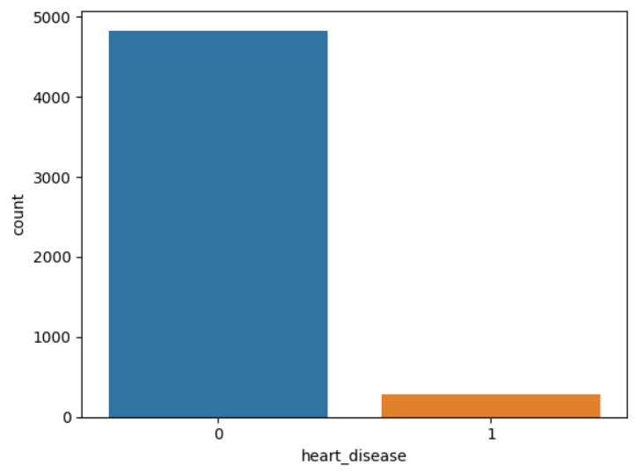
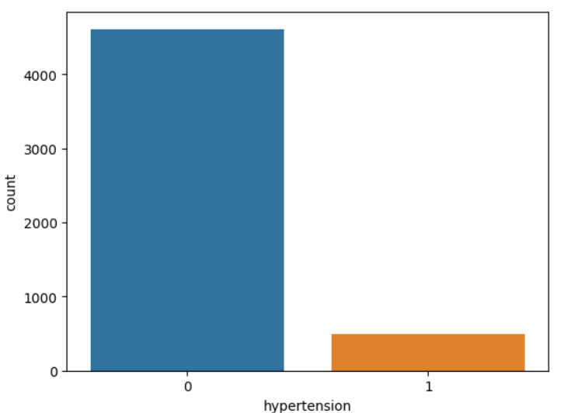
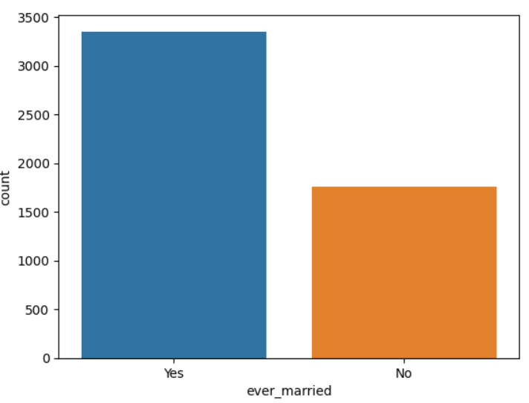
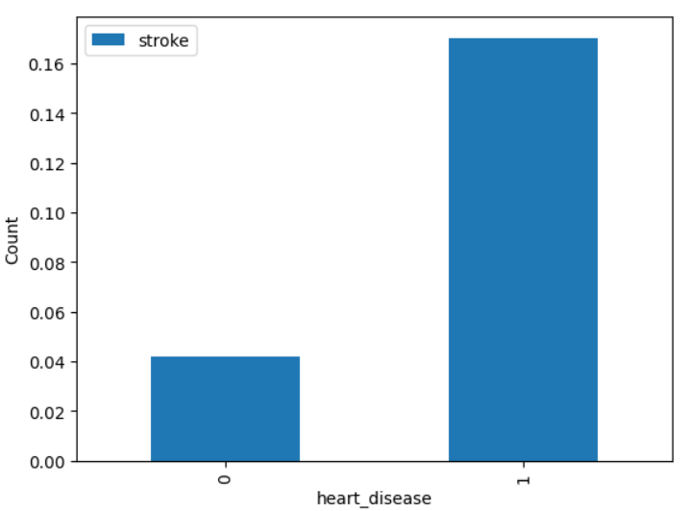
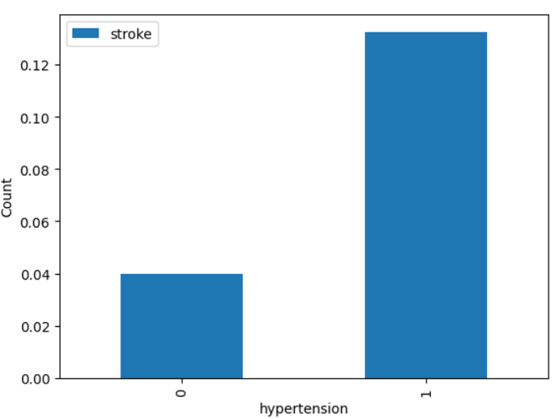
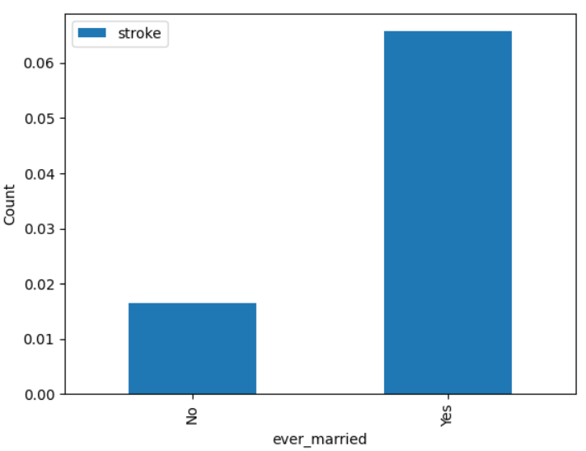
/
Overall Distribution of Features VS Distribution for Individuals Who’ve Had a Stroke
Heart Disease
Hypertension
Ever Married
Overall Distribution
Distribution for Strokes

Slide 7
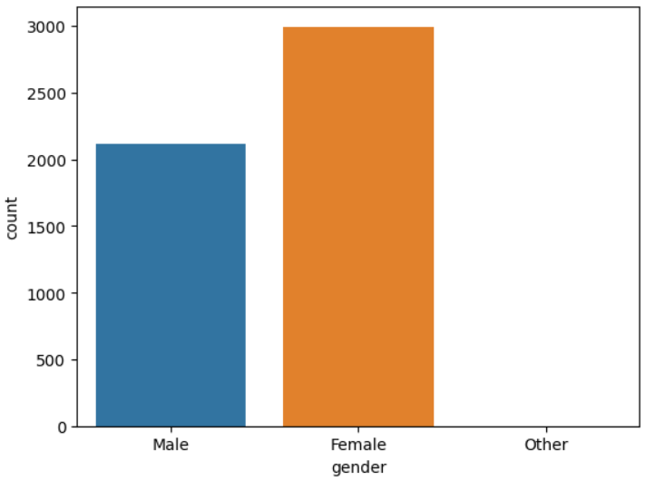
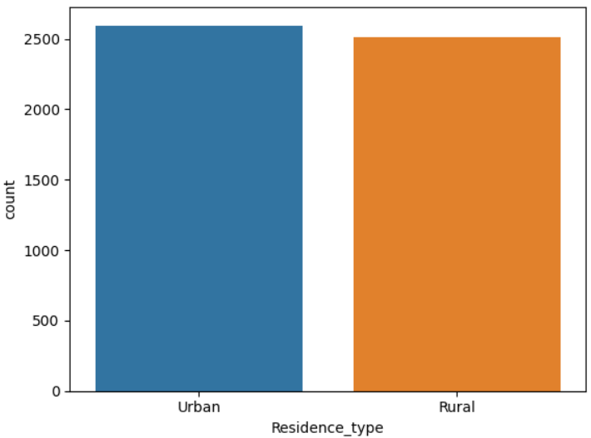
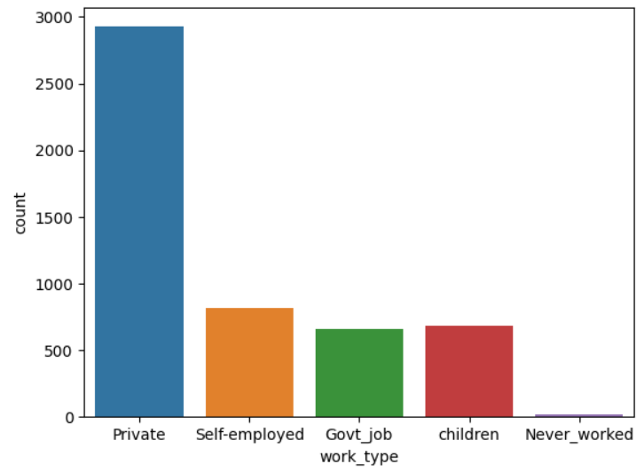
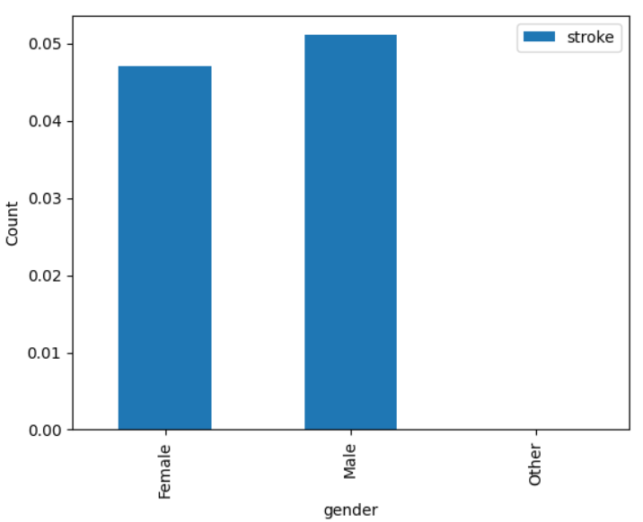
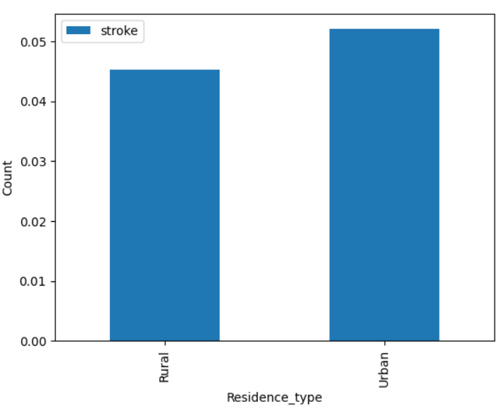
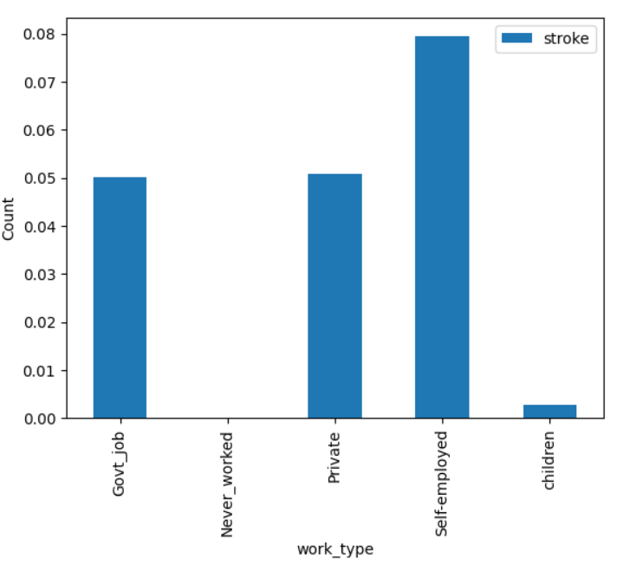
/
Overall Distribution of Features VS Distribution for Individuals Who’ve Had a Stroke
Gender
Residence Type
Work Type
Overall Distribution
Distribution for Strokes

Slide 8
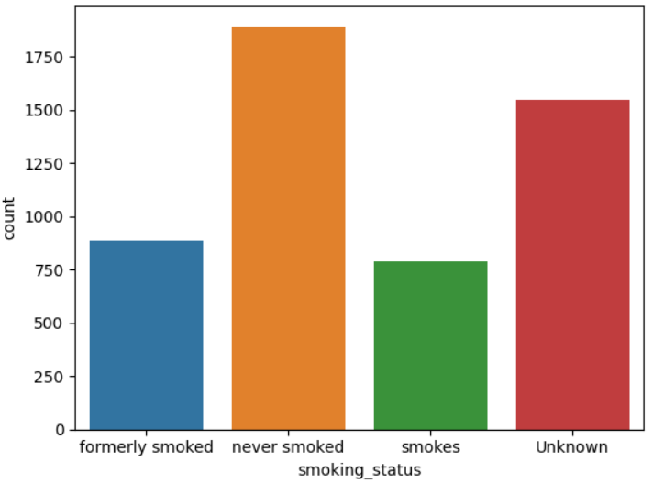
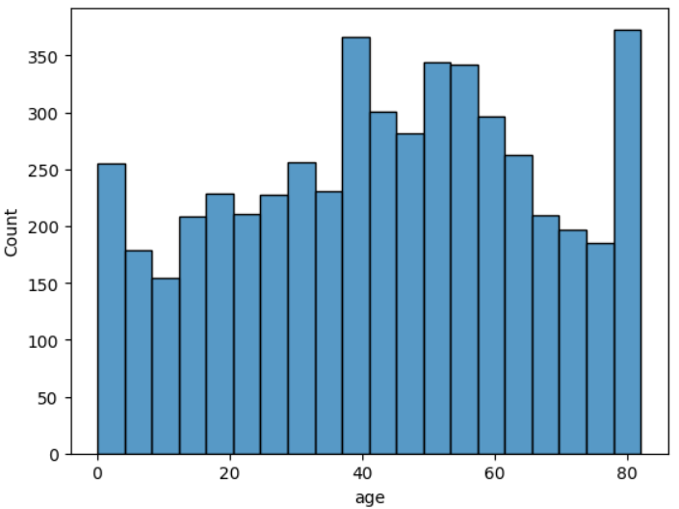
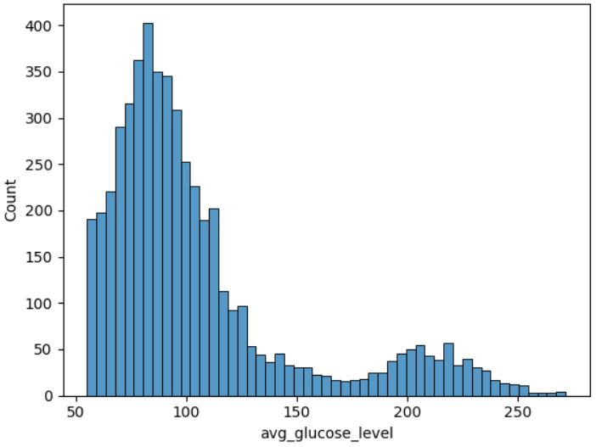
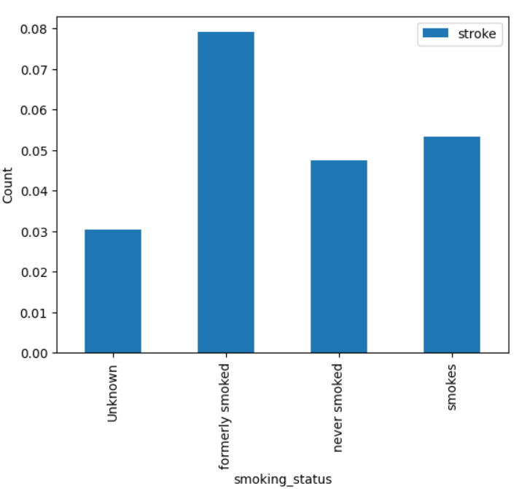
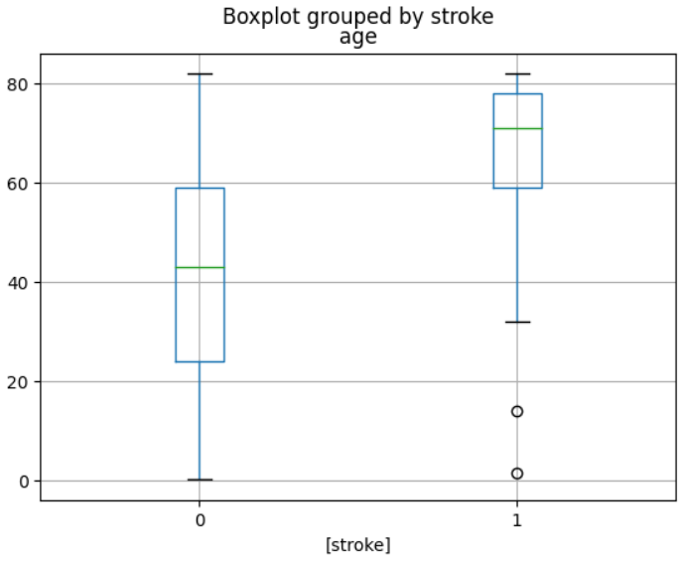
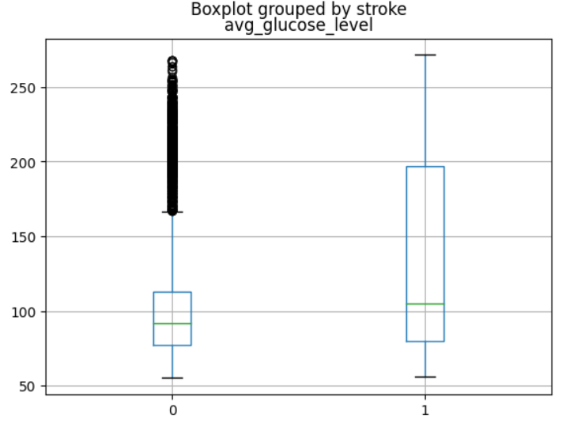
/
Overall Distribution of Features VS Distribution for Individuals Who’ve Had a Stroke
Smoking Status
Age
Average Glucose Level
Overall Distribution
Overall Distribution Histogram
Distribution for Strokes
Distribution Comparison Boxplot

Slide 9
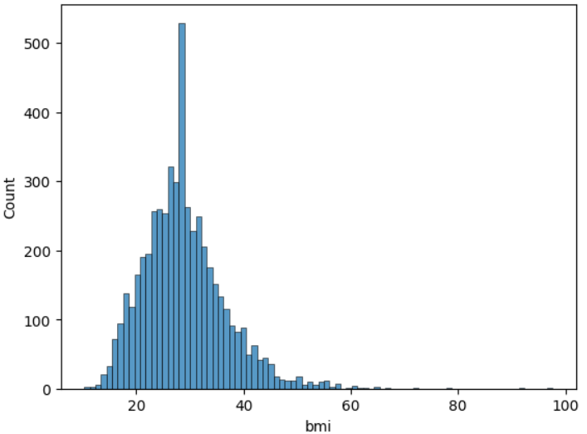
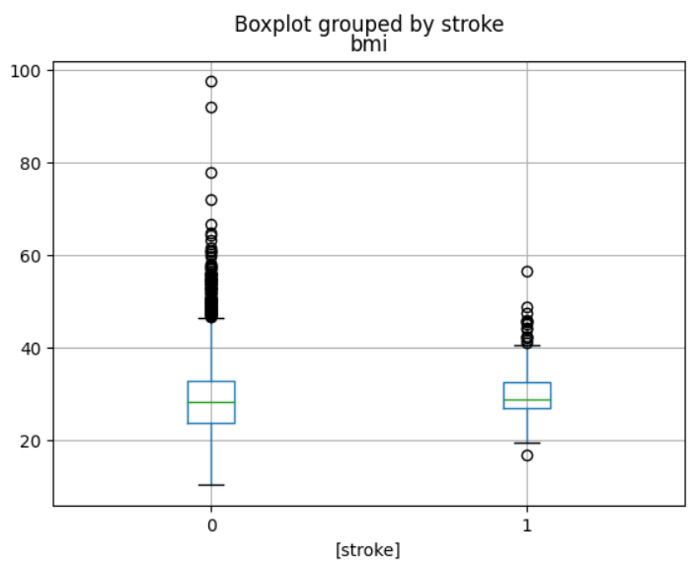
/
Overall Distribution of Features VS Distribution for Individuals Who’ve Had a Stroke
BMI
Notes
Categorical Data:
Although the overall data has significantly more individuals with no heart disease and hypertension, of the individuals who’ve had strokes, the majority have heart disease and/or hypertension.
Although females are in the majority in the overall data, among the individuals who’ve had strokes, males are in the majority.
The most common job for individuals who’ve had a stroke is self- employed. Private is the most common by far in the overall distribution.
Never Smoked is in the majority in the overall distribution, however formerly smoked is in the majority among individuals who’ve had a stroke.
The distribution for residence type and ever married appears to be roughly the same overall and for individuals who’ve had a stroke.
Overall Distribution
Numerical Data:
The average age for the individuals who’ve had strokes is higher than the average age for the individuals who haven’t had a stroke.
The glucose level for individuals who’ve had a stroke tends to be higher than individuals who haven’t had a stroke.
The minimum BMI for individuals who’ve had a stroke is higher than for the individuals who have not had a stroke.
Distribution for Strokes

Slide 10

Data Modeling

Slide 11
Data Modeling Steps
Get Dummies
Get dummies for categorical features
Scale
Scale numerical features
Split
Split into test and train set (80%/20%)
Create and compare
Create and compare several models using the Recall Score.

Slide 12
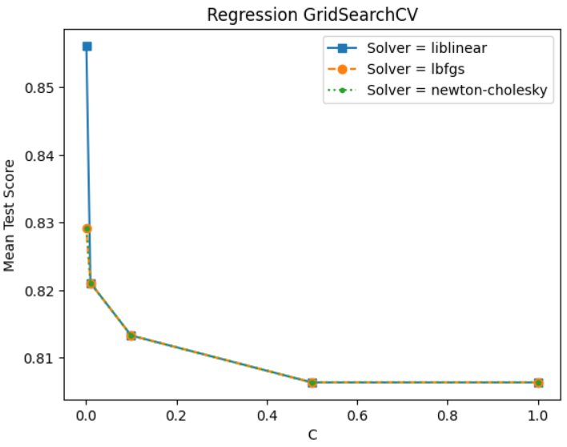
Grid Search – Logistic Regression Model
Hyperparameters Compared
solver: lbfgs, liblinear, newton-Cholesky
C: 1, 0.5, 0.1, 0.01, 0.001
Results
- Noted that the liblinear solver with a C value of 0.001 had the best results.
- This had a Recall score of 0.8561.

Slide 13
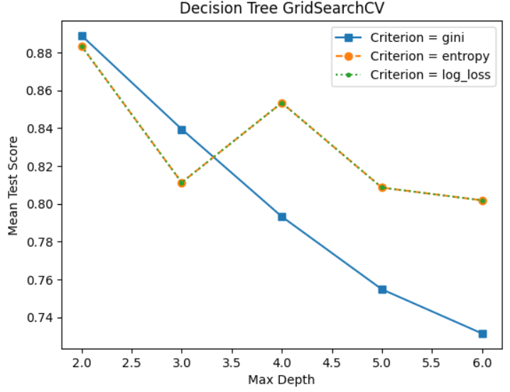
Grid Search – Decision Tree Model
Hyperparameters Compared
criterion: gini, entropy, log_loss
max_depth: 2,3,4,5,6
Results
- Noted that the gini criterion with a max depth value of 2 had the best results.
- This had a Recall score of 0.8889.

Slide 14
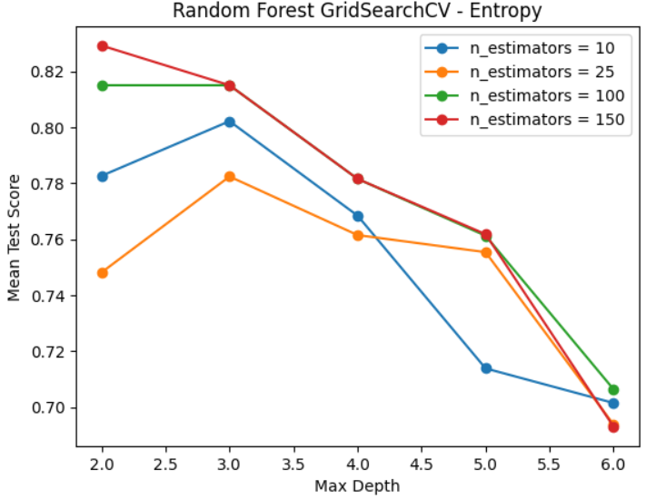
Grid Search – Random Forest Model
Hyperparameters Compared
criterion: gini, entropy, log_loss
max_depth: 2,3,4,5,6
n_estimators: 10,25,100,150
* Per the grid search, noted that the entropy model was the most effective model. The chart on the right is comparing the various max_depth and n_estimator values for the entropy model.
Results
- Noted that the entropy criterion with a max depth value of 2 and an n_estimators value of 150 had the best results.
- This had a Recall score of 0.8291.

Slide 15
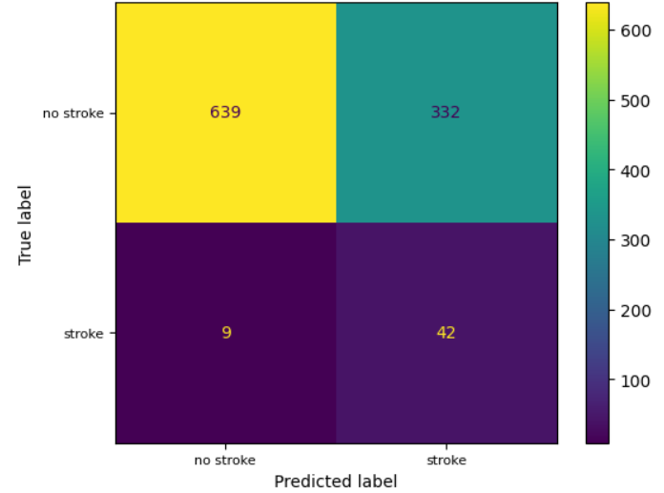
Best Model – Decision Tree Model
Noted that the model with the highest recall score is the Decision Tree model with a score of 0.8889.
This model was able to predict 42 of the 51 instances of stroke accurately.

Slide 16
Assumptions, Limitations, and Disclaimers
The data around individuals who have had strokes is limited as there are only 51 lines of data as opposed to the 971 lines of data for individuals who have not had strokes.
A more balanced dataset would help improve the model.
In order to judge performance of this model, We are assuming that the individual in the dataset who have not had a stroke, will not have a stroke in the future. In reality, there is a chance that individuals who have not had a stroke, may have one in the future.
There was a large number of unknown values for the smoking status column, it was the second most frequent response. As there was an extensive number of unknowns, we were unable to drop those values. Having more reliable data around the smoking status for each individual would improve the model.

Slide 17
Recommendations
This model can be used in the following ways:
Hospitals can use this model to identify individuals who are at significant risk for having a stroke and can provide those patients with targeted preventative treatments.
Pharmaceutical companies can also partner with hospitals and use this model to identify individuals who may be candidates for clinical trials for medications that prevent strokes.
This model could be used by consumers directly to identify whether they are at a high risk for getting a stroke. If they are at a high risk, they can start implementing lifestyle changes to lower their chances of getting a stroke.

Slide 18
Next Steps
Upon checking the features importance for the final model, we noted that this model is only using the age column to make predictions. This heavy reliance on the “age” column may be overfitting the model.
Potential Solutions:
Remove the “age” column completely and train the model with the other features.
Filter data to only include individuals that are the ages that people typically get a stroke. Then remove the age column and rely on other features to train the model.
Remove the age column to train a separate model, then use the best parameters from that on this model that includes age.

Slide 19
Thank you!

